Slide 1
Presented by: Kristy Saha 1607113 Tanusree Das Tithy 1607120
App Name:
Better Life

Slide 2
Introduction:
Who doesn’t know that “Health is Wealth”. Being healthy is the most cherished dream of all people to lead a long life. In order to have a healthy life we need to maintain a balanced diet, proper exercise according to age and health status and enough rest. But nowadays in our busy life schedule we can’t manage time for counseling with the dietitian for balanced diet or trainer to know about proper exercise. So we are trying to launch this app for targeting these mess people so they can have a proper direction for maintaining a balanced diet and enough exercise and rest.

Slide 3

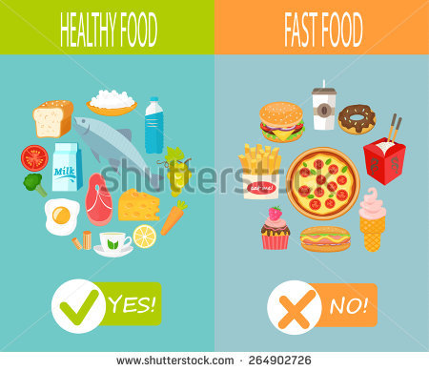

Slide 4
Features
1.Creating Account :
User have to open an account providing his age , height ,weight and some personal information .
2. Ask about disease:
The app will ask whether the user have any serious health issues like heart problems or Diabetes etc and it will provide services according to the disease .
3.Providing a balanced diet:
Giving a diet plan according to personal profile which is already provided first. And it will give notifications when it is time for consuming the food.

Slide 5
4.Notifications :
As we know, having enough water is a hard and first rule of a good health It will give notifications of having water after a specific duration in whole day and will also notify the user about meals and exercise .
5.Providing exercise lists:
Perfect exercise steps will be shown to user according to their personal profile and it will also provide perfect time and duration for exercising like
a professional trainer.

Slide 6
6.Daily calculating overall progress :
After passing the whole day, the user have to submit his meal which he had all day and the app will calculate the total calories consumed by the user. Moreover, it will inform whether there is lacking or excess of calories which have to be fulfilled next day. 7.Providing resting period:
Last but not the least, it will give a proper time duration for taking rest and enough sleep for user according to the age of the user.

Slide 7
THANK YOU

